Slide 1
Relational Databases

Slide 2
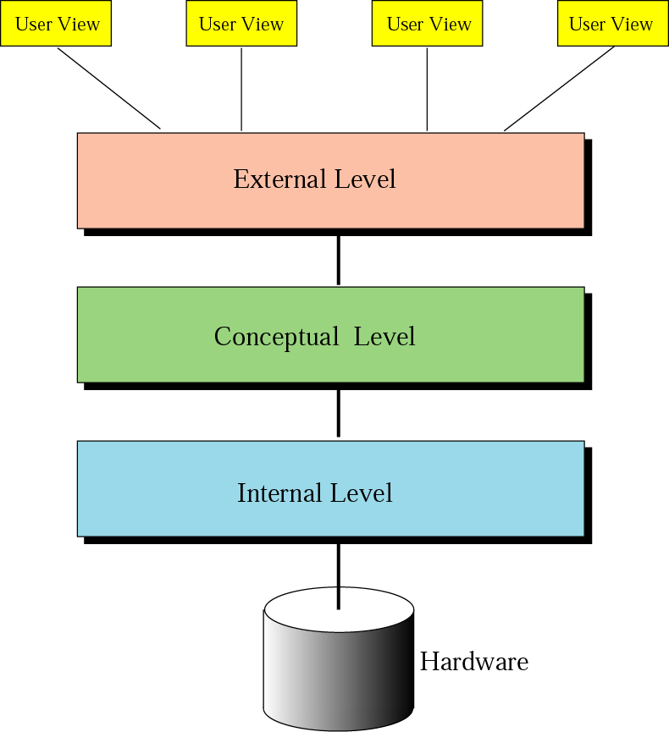
Database
architecture
Figure 14-2

Slide 3
Architecture
Internal level –
  Determines where data are actually stored on the storage device.
  Low-level access method
Conceptual level –
  Defines the logical view of the data
  The main functions of DBMS are in this level.
External level –
  Interacts directly with the user.
  Change the data coming from the conceptual level to a format and view that are familiar to the users.

Slide 4
Relational Model Concepts
The relational Model of Data is based on the concept of a Relation
  The strength of the relational approach to data management comes from the formal foundation provided by the theory of relations
A Relation is a mathematical concept based on the ideas of sets
Slide 5- <number>

Slide 5
Relational Database Definitions
Entity: Object, Concept or event (subject)
Attribute: a Characteristic of an entity
Row or Record: the specific characteristics of one entity
Table: a collection of records
Database: a collection of tables
Slide 5- <number>

Slide 6
The Relational Database model
Table = Entity = Relation
Table row = tuple = instance
Table column = attribute
Table linkage by values
Entity-Relationship Model
Slide 5- <number>

Slide 7
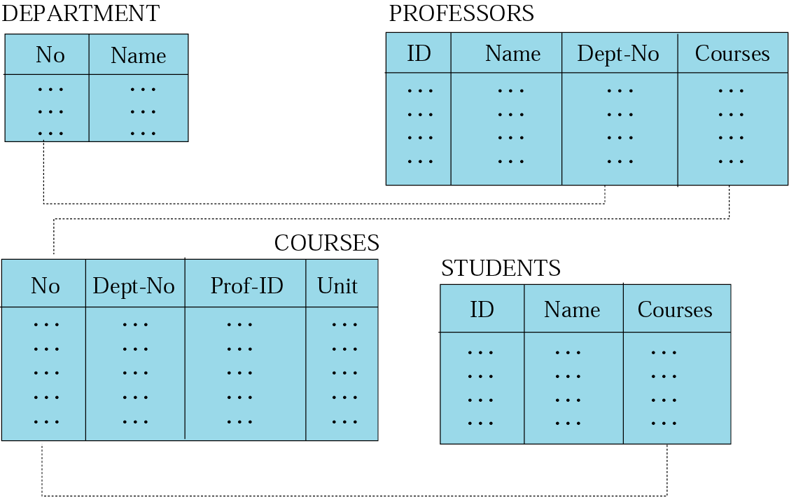
Figure 14-5
Relational model
Data are organized in two-dimensional tables called relations.
The tables are related to each other.
The most popular model.
Slide 5- <number>

Slide 8

Example of a Relation

Slide 9
Informal Definitions
Informally, a relation looks like a table of values.
A relation typically contains a set of rows.
The data elements in each row represent certain facts that correspond to a real-world entity or relationship
  In the formal model, rows are called tuples
Each column has a column header that gives an indication of the meaning of the data items in that column
  In the formal model, the column header is called an attribute name (or just attribute)
Slide 5- <number>

Slide 10
Basic Structure
Formally, given sets D₁, D₂, …. D_{n} a relation r is a subset of
D₁ x D₂ x … x D_{n}
Thus, a relation is a set of n-tuples (a₁, a₂, …, a_{n}) where each a_{i} ∈ D_{i}
Example: If
  customer_name = {Jones, Smith, Curry, Lindsay, …} /* Set of all customer names */
  customer_street = {Main, North, Park, …} /* set of all street names*/
  customer_city = {Harrison, Rye, Pittsfield, …} /* set of all city names */
  Then r = { (Jones, Main, Harrison),
  (Smith, North, Rye),
  (Curry, North, Rye),
  (Lindsay, Park, Pittsfield) }
  is a relation over
customer_name x customer_street x customer_city
Slide 5- <number>

Slide 11
Database
A database consists of multiple relations
Information about an enterprise is broken up into parts, with each relation storing one part of the information
account : stores information about accounts
depositor : stores information about which customer
owns which account
customer : stores information about customers
Storing all information as a single relation such as
bank(account_number, balance, customer_name, ..)
results in
  repetition of information
    e.g.,if two customers own an account (What gets repeated?)
  the need for null values
    e.g., to represent a customer without an account
Normalization theory. deals with how to design relational schemas
Slide 5- <number>

Slide 12
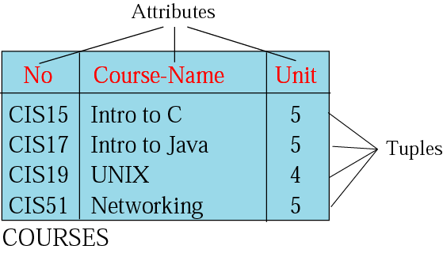
Relation
Figure 14-6
Name – each relation in a relational database should have a name that is unique among other relations.
Attribute – each column in a relation.
  The degree of the relation – the total number of attributes for a relation.
Tuple – each row in a relation.
  The cardinality of the relation – the total number of rows in a relation.

Slide 13

Example of a Relation
Slide 5- <number>

Slide 14

The customer Relation
Slide 5- <number>

Slide 15

The depositor Relation
Slide 5- <number>

Slide 16
Relational Database Management System (RDBMS)
Table A
Name Address Parcel #
John Smith 18 Lawyers Dr. 756554
T. Brown 14 Summers Tr. 887419
Table B
Parcel # Assessed Value
887419 152,000
446397 100,000

Slide 17
Relational keys
Must be able to store and retrieve a row of data in a relation, based on the data values stored in that row
A primary key is an attribute (or combination of attributes) that uniquely identifies each row in a relation.
The primary key in the EMPLOYEE1 relation is EMP_ID (this is why it is underlined) as in:
EMPLOYEE1(Emp_ID,Name,Dept,Salary)
Slide 5- <number>

Slide 18
Database Keys
Primary Key - Indicates uniqueness within records or rows in a table.
Foreign Key - the primary key from another table, this is the only way join relationships can be established.
There may also be alternate or secondary keys within a table.

Slide 19
Keys
Let K ⊆ R
K is a superkey of R if values for K are sufficient to identify a unique tuple of each possible relation r(R)
  by “possible r ” we mean a relation r that could exist in the enterprise we are modeling.
  Example: {customer_name, customer_street} and
  {customer_name}
  are both superkeys of Customer, if no two customers can possibly have the same name
    In real life, an attribute such as customer_id would be used instead of customer_name to uniquely identify customers, but we omit it to keep our examples small, and instead assume customer names are unique.
Slide 5- <number>

Slide 20
Keys (Cont.)
K is a candidate key if K is minimal
Example: {customer_name} is a candidate key for Customer, since it is a superkey and no subset of it is a superkey.
Primary key: a candidate key chosen as the principal means of identifying tuples within a relation
  Should choose an attribute whose value never, or very rarely, changes.
  E.g. email address is unique, but may change
Slide 5- <number>

Slide 21
A Key
A (primary) key is one (or more) columns of a relation that is (are) used to identify a row
A composite key is a key that contains two or more attributes
  For a key to be unique, it is sometimes necessary to use a composite key
  Can also generate a set of unique values to serve as the key (for example University ID numbers)

Slide 22
A Foreign Key
A table may be related to other tables (i.e., a relationship)
To create relationships, you may need to create a foreign key
A foreign key is a primary key from one table placed into another table
Referential integrity - every value of a foreign key must match a value of an existing primary key

Slide 23
Composite and foreign keys
A Composite key is a primary key that consists of more than one attribute.
e.g., the primary key for the relation DEPENDENT would probably consist of the combination Emp-ID and Dependent_Name
A Foreign key is used when we must represent the relationship between two tables and relations
A foreign key is an attribute (possibly composite) in a relation of a database that serves as the primary key of another relation in the same database
Slide 5- <number>

Slide 24
Foreign Key Example
Project
Proj_Num
Proj_Name
MgrID
Manager
MgrID
MgrName
Primary Key
Relationship
Foreign Key

Slide 25
Foreign keys
  Consider the following relations:
  EMPLOYEE1(Emp_ID,Name,Dept_Name,Salary)
  DEPARTMENT(Dept_Name,Location,Fax)
  The attribute Dept_Name is a foreign key in EMPLOYEE1. It allows the user to associate any employee wit the department they are assigned to.
  Some authors show the fact that an attribute is a foreign key by using a dashed underline.
Slide 5- <number>

Slide 26

Foreign Keys
A relation schema may have an attribute that corresponds to the primary key of another relation. The attribute is called a foreign key.
  E.g. customer_name and account_number attributes of depositor are foreign keys to customer and account respectively.
  Only values occurring in the primary key attribute of the referenced relation may occur in the foreign key attribute of the referencing relation.
Slide 5- <number>

Slide 27
Formal Definitions - Schema
The Schema (or description) of a Relation:
  Denoted by R(A1, A2, .....An)
  R is the name of the relation
  The attributes of the relation are A1, A2, ..., An
Example:
CUSTOMER (Cust-id, Cust-name, Address, Phone#)
  CUSTOMER is the relation name
  Defined over the four attributes: Cust-id, Cust-name, Address, Phone#
Each attribute has a domain or a set of valid values.
  For example, the domain of Cust-id is 6 digit numbers.
Slide 5- <number>

Slide 28
Formal Definitions - Tuple
A tuple is an ordered set of values (enclosed in angled brackets ‘< … >’)
Each value is derived from an appropriate domain.
A row in the CUSTOMER relation is a 4-tuple and would consist of four values, for example:
  <632895, "John Smith", "101 Main St. Atlanta, GA 30332", "(404) 894-2000">
  This is called a 4-tuple as it has 4 values
  A tuple (row) in the CUSTOMER relation.
A relation is a set of such tuples (rows)
Slide 5- <number>

Slide 29
Formal Definitions - Domain
A domain has a logical definition:
  Example: “USA_phone_numbers” are the set of 10 digit phone numbers valid in the U.S.
A domain also has a data-type or a format defined for it.
  The USA_phone_numbers may have a format: (ddd)ddd-dddd where each d is a decimal digit.
  Dates have various formats such as year, month, date formatted as yyyy-mm-dd, or as dd mm,yyyy etc.
The attribute name designates the role played by a domain in a relation:
  Used to interpret the meaning of the data elements corresponding to that attribute
  Example: The domain Date may be used to define two attributes named “Invoice-date” and “Payment-date” with different meanings
Slide 5- <number>

Slide 30
Example – A relation STUDENT
Slide 5- <number>

Slide 31
Characteristics Of Relations
Ordering of tuples in a relation r(R):
  The tuples are not considered to be ordered, even though they appear to be in the tabular form.
Ordering of attributes in a relation schema R (and of values within each tuple):
  We will consider the attributes in R(A1, A2, ..., An) and the values in t=<v1, v2, ..., vn> to be ordered .
    (However, a more general alternative definition of relation does not require this ordering).
Slide 5- <number>

Slide 32

Same state as previous Figure (but with different order of tuples)
Slide 5- <number>

Slide 33
Characteristics Of Relations
Values in a tuple:
  All values are considered atomic (indivisible).
  Each value in a tuple must be from the domain of the attribute for that column
    If tuple t = <v1, v2, …, vn> is a tuple (row) in the relation state r of R(A1, A2, …, An)
    Then each vi must be a value from dom(Ai)
  A special null value is used to represent values that are unknown or inapplicable to certain tuples.
Slide 5- <number>

Slide 34
Expressing the conceptual schema
Text statements have the advantage of simplicity, whilst the graphical representation provides a better means of expressing referential integrity constraints (discussed later)
Here is a text description for four relations:
CUSTOMER(Customer_ID, Customer_Name, Address, City, State, Zip)
ORDER(Order_ID, Order_Date, Customer_ID)
ORDER_LINE(Order_ID, Product_ID, Quantity)
PRODUCT(Product_ID, Product_Description, Product_Finish, Standard_Price, On_Hand)
Slide 5- <number>

Slide 35
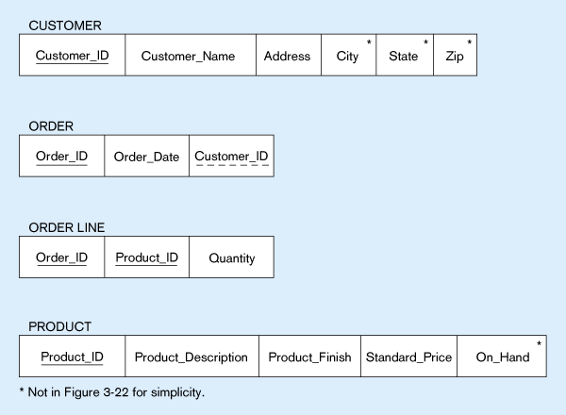
Schema for four relations (Pine Valley Furniture)
Primary Key
Foreign Key (implements 1:N relationship between customer and order)
Combined, these are a composite primary key (uniquely identifies the order line)…individually they are foreign keys (implement M:N relationship between order and product)
Slide 5- <number>

Slide 36
Key
If a relation has several candidate keys, one is chosen arbitrarily to be the primary key.
  The primary key attributes are underlined.
Example: Consider the CAR relation schema:
  CAR(State, Reg#, SerialNo, Make, Model, Year)
  We chose SerialNo as the primary key
  Another Key:{State, Reg#}
The primary key value is used to uniquely identify each tuple in a relation
  Provides the tuple identity
Also used to reference the tuple from another tuple
  General rule: Choose as primary key the smallest of the candidate keys (in terms of size)
  Not always applicable – choice is sometimes subjective
Slide 5- <number>

Slide 37

CAR table with two candidate keys – LicenseNumber chosen as Primary Key
Slide 5- <number>

Slide 38
Relational Database Schema
Relational Database Schema:
  A set S of relation schemas that belong to the same database.
  S is the name of the whole database schema
  S = {R1, R2, ..., Rn}
  R1, R2, …, Rn are the names of the individual relation schemas within the database S
Following slide shows a COMPANY database schema with 6 relation schemas
Slide 5- <number>

Slide 39
Relational Integrity Constraints
Constraints are conditions that must hold on all valid relation states.
There are two main types of constraints in the relational model:
  Entity integrity constraints
  Referential integrity constraints
Another implicit constraint is the domain constraint
  Every value in a tuple must be from the domain of its attribute (or it could be null, if allowed for that attribute)
Slide 5- <number>

Slide 40
Integrity constraints
These help maintain the accuracy and integrity of the data in the database
Domain Constraints - a domain is the set of allowable values for an attribute.
Slide 5- <number>

Slide 41
Entity integrity
In some cases a particular attribute cannot be assigned a data value, e.g. when there is no applicable data value or the value is not known when other values are assigned
In these situations we can assign a null value to an attribute (null signifies absence of a value)
But still primary key values cannot be null – the entity integrity rule states that “no primary key attribute (or component of a primary key attribute) may be nullEntity
Slide 5- <number>

Slide 42
Referential Integrity
Referential integrity concerns two or more tables that are related.
Example: IF table A contains a foreign key that matches the primary key of table B THEN values of this foreign key either match the value of the primary key for a row in table B or must be null.

Slide 43
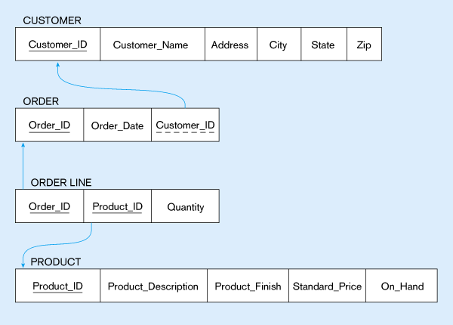
Referential integrity constraints (Pine Valley Furniture)
Referential integrity constraints are drawn via arrows from dependent to parent table
Slide 5- <number>

Slide 44
Referential integrity
How do you know if a foreign key is allowed to be null?
In this example, as each ORDER must have a CUSTOMER the foreign key of Customer_ID cannot be null on the ORDER relation
Whether a foreign key can be null must be specified as a property of the foreign key attribute when the database is designed
Slide 5- <number>

Slide 45
Integrity constraints
A Referential Integrity constraint is a rule that maintains consistency among the rows of two relations – it states that any foreign key value (on the relation of the many side) MUST match a primary key value in the relation of the one side. (Or the foreign key can be null)
In the following Fig., an arrow has been drawn from each foreign key to its associated primary key. A referential integrity constraint must be defined for each of these arrows in the schema
Slide 5- <number>

Slide 46
Strategies for managing Integrity
You could ignore it, but it costs you time.
Place the Burden on your customer or user.
Have the programmers “fix the problem”
Place the burden on the Database Management System (DBMS)

Slide 47
Entity Integrity
Entity Integrity:
  The primary key attributes PK of each relation schema R in S cannot have null values in any tuple of r(R).
    This is because primary key values are used to identify the individual tuples.
    t[PK] ≠ null for any tuple t in r(R)
    If PK has several attributes, null is not allowed in any of these attributes
  Note: Other attributes of R may be constrained to disallow null values, even though they are not members of the primary key.
Slide 5- <number>

Slide 48
Referential Integrity
A constraint involving two relations
  The previous constraints involve a single relation.
Used to specify a relationship among tuples in two relations:
  The referencing relation and the referenced relation.
Slide 5- <number>

Slide 49

COMPANY Database Schema
Slide 5- <number>

Slide 50

Referential Integrity Constraints for COMPANY database
Slide 5- <number>

Slide 51
Other Types of Constraints
Semantic Integrity Constraints:
  based on application semantics and cannot be expressed by the model per se
  Example: “the max. no. of hours per employee for all projects he or she works on is 56 hrs per week”
A constraint specification language may have to be used to express these
SQL-99 allows triggers and ASSERTIONS to express for some of these
Slide 5- <number>

Slide 52
Populated database state
Each relation will have many tuples in its current relation state
The relational database state is a union of all the individual relation states
Whenever the database is changed, a new state arises
Basic operations for changing the database:
  INSERT a new tuple in a relation
  DELETE an existing tuple from a relation
  MODIFY an attribute of an existing tuple
Next slide shows an example state for the COMPANY database
Slide 5- <number>

Slide 53

Populated database state for COMPANY
Slide 5- <number>

Slide 54
In-Class Exercise
Consider the following relations for a database that keeps track of student enrollment in courses and the books adopted for each course:
STUDENT(SSN, Name, Major, Bdate)
COURSE(Course#, Cname, Dept)
ENROLL(SSN, Course#, Quarter, Grade)
BOOK_ADOPTION(Course#, Quarter, Book_ISBN)
TEXT(Book_ISBN, Book_Title, Publisher, Author)
Slide 5- <number>

